Slide 1
The humanization of the economy through social innovation
René Kemp, Tim Strasser, Marc Davidson, Flor Avelino, Bonno Pel, Adina Dumitru, Iris Kunze, Julia Backhaus, Tim O’Riordan, Alex Haxeltine and Paul Weaver
Based on research for the TRANSIT project http://www.transitsocialinnovation.eu/

Slide 2
Overview
Introduction
The double movement identified by Polanyi
The welfare state
The humanization of economic life
A world of three movements

Slide 3
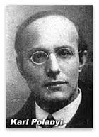
1. Introduction
Karl Polanyi: described a double movement in society:
The first movement is towards marketization, the spread of market thinking and market-based forms of allocation throughout society, driven by international trade and naturalist ideas of competition and utilitarianism.
The second countermovement consists of (state-based) social protection against the negative consequences of that same marketization
We suggest, the double movement model is best changed into a three movement model with
a third movement called the humanization of the economy involving a re-embedding as the opposite of dis-embedding: the loss of social ties and sense of purpose in individualistic societies, not in the sense of a restoring the past. It is also driven by the need for autonomy.

Slide 4
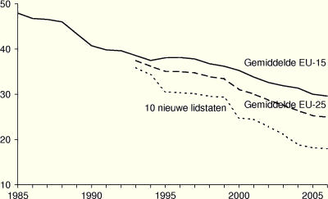
2. Marketization of society
From a market economy to a market society (Sandel, 2000, 2012):
A market society is a way of life in which market values seep into every aspect of human endeavour. … Market-ideology has penetrated families and government.
The ascendance of market society is partly the result of the ideology of neoliberalism and partly the result of self-reinforcing processes (such as global competition leading governments to reduce corporate taxes and reform the welfare state, materialism, etc.

Slide 5
3. The welfare state
Pathologies of the welfare system
Erosion of community resilience: the emergence of a co-dependence on both market-based solutions and state welfare, at the cost of traditional forms of social relations and informal modes of exchange.
The limited success of polices aimed at addressing social exclusion because reintegration activities are too much oriented towards the market economy.
The persistence of long-term, sometimes trans-generational, unemployment among a significant minority of the working-age population, combined with treating unemployment benefit receivers in a non-human way, through the use of bureaucratic rule, orders and the use of sanctions.
The welfare system is not oriented towards the integrity and capabilities of people, and because of this it undermines the “freedom of the self to assume life in such a way that it is expressive of his or her integrity as a self” (Yeatman, Dowsett, Fine & Gursansky, 2009, p.4)

Slide 6
3. The welfare state (continued)
Market thinking also entered the systems of social care: efficiency-driven norms alienated health-care professionals and dehumanized patients (Laloux, 2014).
“The whole day, the electronic registration system that you have to carry with you is making you crazy. Some evenings I had to go and see 19 different patients. Then there is nothing you can do but run inside, put on a bandage or give a shot, and run out. You can never finish your work in a qualitative way.”
“The last years I was responsible for 80 patients that I never got to know well. … The planning was done somewhere else by someone who didn’t know the patients. […] Nobody felt responsible for the care of patients. Every day there were complaints and conflicts among colleagues.”

Slide 7
4. The humanisation of economic life
The diverse economy: there always has been an alternative economy in which values of cooperation and mutuality govern economic interactions.
Our proposition: there is a third movement in the form of a humanization process
Shared underlying values: people as persons > objects (statistics), intrinsic > extrinsic motivations, purposeful activities, collective benefits.
Not a separate sector (such as the third sector), but in all sectors (in different ways and at different speeds).
The activities discussed are: commons-based peer production, time banks, eco-villages and transition towns, home care, family group conferences, Teal organizations (Buurtzorg).
These are all part of a “movement” which so far has no name
and is without political parties speaking on its behalf.

Slide 8
The humanisation of the economy through social innovation
We conceptualise humanization of the economy as the development of economic activities that help satisfy basic psychological needs for autonomy, relatedness and competence with an important role for ego-transcendence in serving a greater cause and acting for the benefit of all.
We hypothesise that (1) the current economic system to a large extent fails in satisfying basic psychological needs, and that (2) there is a societal movement of alternative economy activities that are better at satisfying those needs.
We refer to such alternative economy activities in terms of ‘social innovation initiatives’, conceptualised as initiatives that involve new social relations and new ways of doing, organising, framing and knowing (Haxeltine et al. 2013, 2016, Avelino et al. forthcoming).

Slide 9
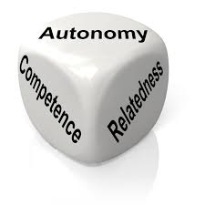
Self-determination theory
“people have innate psychological needs that are the basis for self-motivation and personality integration. (...) SDT identifies three innate needs that, if satisfied, allow optimal function, growth and wellbeing”
Competence: the ability to control the outcome and experience mastery
Relatedness: feeling connected to others and experience caring for others
Autonomy: to act in harmony with one's integrated self (based on intrinsic motivations)
Notes:
Autonomy does not mean independence from others, as this will confict with the need to feel and experience connected to others. SDT distinguishes between intrinsic and extrinsic motivations. if intrinsically motivated behaviour becomes controlled by external rewards, autonomy is being undermined.

Slide 10
According to a Gallup survey in 2011-2012, across the world only 13% of the workers are engaged, in the sense of psychologically committed to their jobs and goals of the organization. 63% are not engaged and 24% are actively disengaged
Source: http://www.gallup.com/poll/165269/worldwide-employees-engaged-work.aspx

Slide 11
The third movement involves people from different walks of life: individualists interested in making a difference, communitarian minded people who start a co-op and engage in activities outside the market economy, social entrepreneurs seeking positive social impacts and municipalities who are experimenting with citizen participation and the collective management and use of public spaces (as urban commons)
The humanisation process of transformative social innovation is believed to exhibit a rising trend in the last 20 years, after a decline during the expansion of the welfare system, with a proliferation of initiatives in the last 10 years (in the West).

Slide 12
Historical dynamics of three movements
WTO
Deregulation of financial sector
TTIP
Human resource management
Monetary easing & Austerity Programs
Rise in Regional Trade Agreements
Paid work by married women
Fall of Berlin
Wall
Marketization
Bretton Woods
system
Reagonomics
New Labor
Market-friendly reforms & policies
Beggar-thy-
neighbour
policies
Thatcher
elected
Economic recovery & growth
Reign of Neoliberalism
New Public
Management
Rise of right-wing populists
Welfare legislation
Discussion about trade protection in US elections
State Protectionism
Environmental laws
Reform of
welfare state
Creation of modern
welfare state
Expansion of welfare state
Sanctions & obligations for welfare recipients
Rio conf.
Kyoto protocol
Rio 20+
Broad process of emancipation
Women’s movement
Rio local agenda
Fair Trade organizations
Open Source
Humanization
P2P Sharing Economy
Women’s suffrage
Rise of environmental movement
Book: The Great
Transformation
Urban commons
Hippie movement
Rise in communitarianism
1930
1940
1950
1960
1970
1980
1990
2000
2010
2020
Fascism
WWII
World
Financial Crisis

Slide 13
De-objectification
& re-enchantment of nature
Environmental protection
Environmental degradation across the world
Disembedding cycle
Ecosystem regeneration / Permaculture
Decline of family
Commons-based ownership & production
Utilitarianism
Objectification of nature
Loss of meaning and social identity
Collective living & working
Neo-liberalism
Re-embedding cycle
Individualism
Conscious consumption
Global econ. competition
For profit Marketisation
Objectification of people
Consumption & consumerism
Hedonism
Humanisation
Rising self-employment / entrepreneurship
Performance stress
Debt
Economic growth as main orientation
Corporate power
autonomy & purpose-driven work
Economic uncertainty
Economic stress cycle
Downward tax competition
Wealth
Local resilience
Initiatives & networks
Undermining of state sovereignty
Fear and intolerance
Humanisation
State-based welfare in reform
Self-organized civic services
Political economy cycle
Arrows of influence in relation to marketisation in the world of today (after 2000)

Slide 14
 | First movement (marketization) | Second movement ( social protection) | Third movement ( humanization)
Institutional aim | Establishment of a self-regulating market | Conservation of man and nature as well as productive organization | Re-embedding of values of mutuality, social purpose and respect in economic relationships, in a way that offers conditions for humane human development and ecological thriving
Support of social forces | Trading classes | Those most immediately affected by deleterious action of the market: primarily, but not exclusively, the working and the landed classes | Those who are disenchanted by present arrangements for work and welfare state duties and seek to enhance human well-being through autonomy-enhancing solutions
Organizing principle(s) | Laissez-faire and free trade | Protective legislation, accountability demands and other instruments of intervention | Self-organization and purpose-orientation, generating a fitting context for autonomy, relatedness and competence.
Emerged in response to… | Inefficiency, feudalism, and oppressiveness of state-based rule | Dis-embedding effects of laissez-faire economic (neo)liberalism: i.e. objectification of man & nature and economic stress cycle | Inadequacy of protection- and hierarchy-based responses to dis-embedding effects of neoliberalism

Slide 15
Attitude towards hierarchy and centralization | Minimal state which upholds property rights and safeguards public goods. | Unproblematic. Subordination of individual behaviour to organizational and societal goals | Hierarchical control causes human disempowerment and alienation; natural “actualization hierarchies” based on competence and purpose are catered for
Dominant type of motivation | Extrinsic motivation based on acquiring status position above others in competitive social hierarchy | Extrinsic motivation based on functional roles for the interest of bureaucratically managed social value. | Autonomous motivation (internalized, integrated or intrinsic motivation) based on personal values & meaningful purpose.
Consequence for (concept of) selfhood | Celebration of individualism with little consideration of alienated or egotistic self | Individual as statistical fact. Not much attention is given to the authentic self in the application of bureaucratic rule | Authentic, self-actualized self. Important role for self-fulfillment through serving a greater cause / acting for the collective good
Welfare concept | Economic growth & “trickle-down” justification for the super wealth of individuals | Economic growth with top-down welfare redistribution to those in need | A good life (e.g. Buen Vivir) with important role for personal growth and well-being: society benefits from human/social wealth; no primacy of material wealth
View on freedom | Freedom of individuals from interference from others (bonds are seen as ties and instrumental means) | Freedom within constraints (to avoid exploitation) | Social bonds based on trust and mutuality constitute the means of our freedom

Slide 16
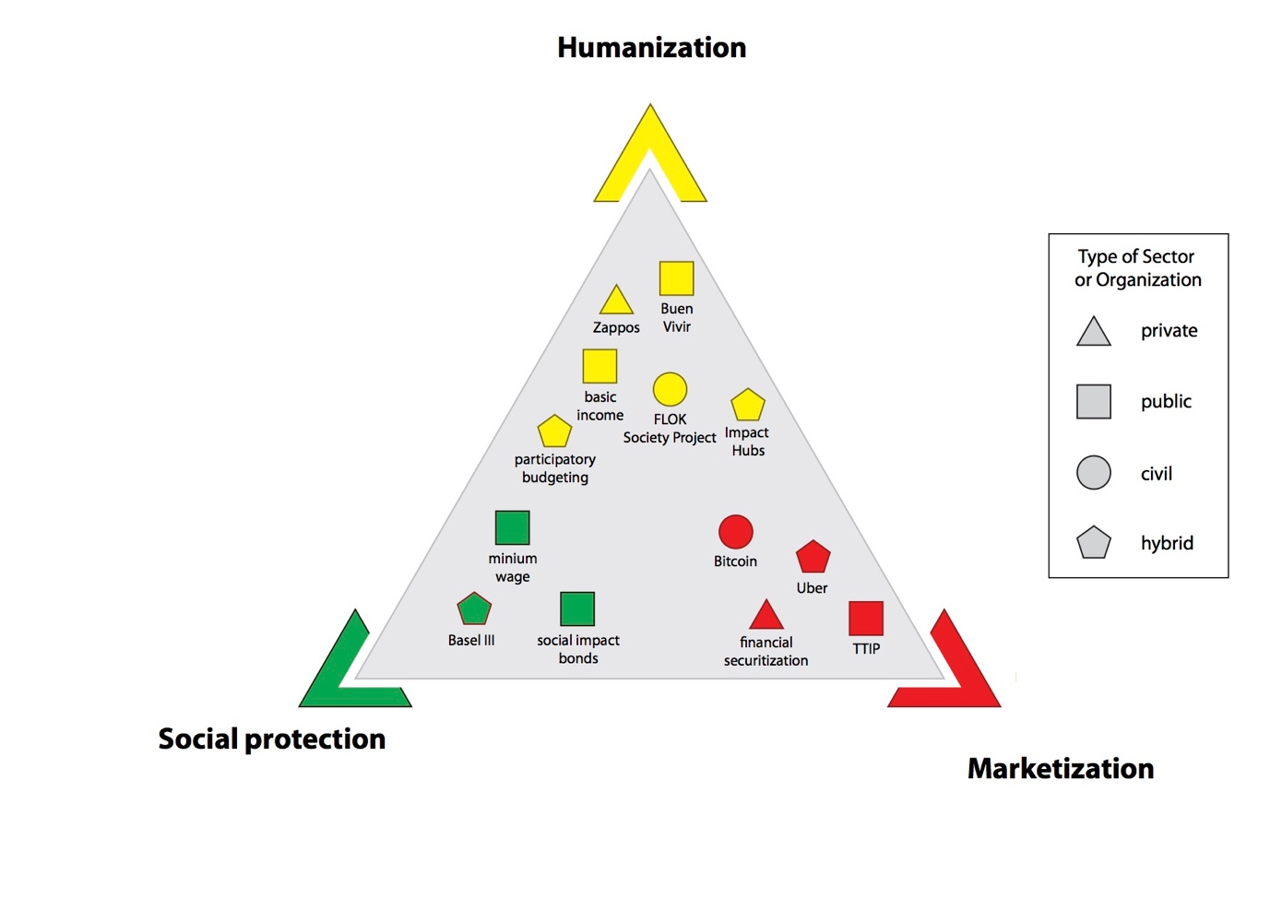

Slide 17
5. A world of three movements
Through the growth of alternative economy activities based on (transformative) social innovation, a “new normal” is emerging next to “old ways of doing things”
Each of the movements harbours different logics. No movement or domain is based on a singular logic (espoused values only partially correspond with values in use).
All movements have valuable elements and the challenge of creating a better world does not lie in the elimination of any of the logics but in combining them. This is a difficult task which must be taken up continuously since the three logics involve tensions.

Slide 18
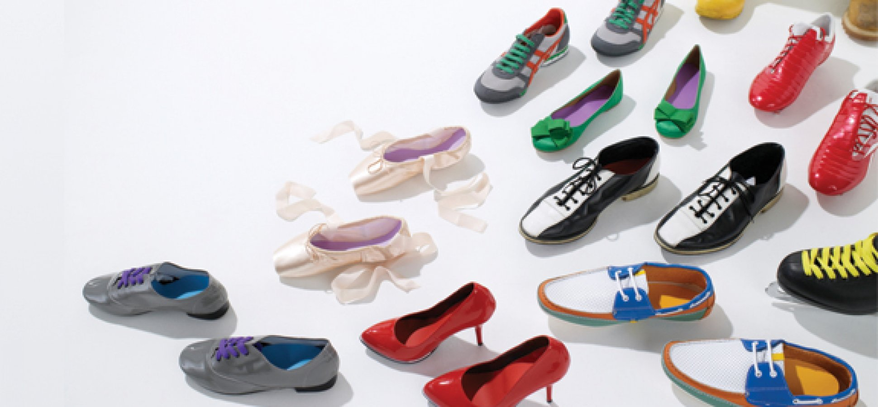
Humanization activities occur across society (including the market economy and - to a smaller extent - in government).
It is a pluriform movement
Political philosophies of liberalism (the humanistic version with an important role for self-actualization and ethics) and communitarianism are being combined.
A challenge for the third movement is to bring about major institutional change in the political economy of the world.
As any movement, it will experience downfalls and retreat, but the motivations on which it is based are not those of a special class or group of people (green communitarians) but basic psychological needs, which therefore can be expected to assert themselves also in business and government.

